Slide 1
Women’s cloth prediction system
-Using KNN Clustering

Slide 2
Agenda
Provide a simple yet effective way to pick clothes
Help narrow the current genre based on user bias
To help the retailers and e-commerce platforms to use the summary of customer feedback to improve the quality of the products.

Slide 3
What is the need?
When choosing a particular cloth the customer at present has to go through the reviews presented to them. When selecting through just a few reviews, it can be most effectively done through simply reading the comments. However, if you have thousands and sometimes even hundreds of thousands of reviews on a consistent basis, reading all the feedback can be difficult if not impossible. Currently, Sentiment analysis can be very useful because it can help businesses to differentiate themselves in certain ways and therefore stand out from the crowd of competitors to vie for the attention of customers.

Slide 4
How do we achieve it?
We analyse the whole dataset and come up with a classifier by using machine learning concepts like K Nearest Neighbours algorithm. We also analyse the whole dataset to support the correctness of our classifier. Thus, sentiment analysis can be of great help in providing directional insight and for paving the way for further analysis, insight and appropriate action.

Slide 5
How do we achieve it?
PRE-PROCESSING
DISPLAYING THE TOP TEN RESULTS THROUGH A SIMPLE GUI
SPLITTING THE MODEL INTO TEST AND TRAIN DATASET
CALCULATING THE POLARITY
APPLYING THE KNN ALGORITHM

Slide 6
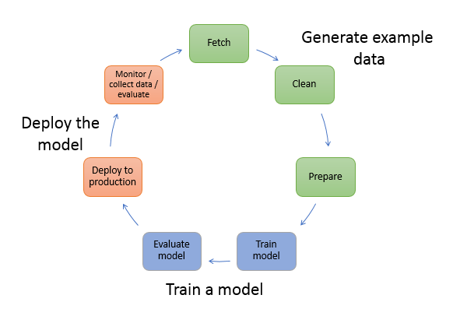
Model Life-Cycle

Slide 7
Requirements
HARDWARE REQUIREMENT
RAM of minimum configuration.
Hard disk of minimum configuration or higher.
Any Intel/AMD Processor
Speed 1Ghz or more

Slide 8
Requirements
SOFTWARE REQUIREMENT
Dataset of an e-commerce platform
Python-V 3
Virtual python environment
Spyder IDE
NLTK Library
Matplotlib Library
Pandas and numpy libraries.
Tkinter library

Slide 9
WORK FLOW
PRE-PROCESSING
CALCULATING THE POLARITY
SPLITTING THE MODEL INTO TEST AND TRAIN DATASET
APPLYING THE KNN ALGORITHM
DISPLAYING THE TOP TEN RESULTS THROUGH A SIMPLE GUI

Slide 10
PRE-PROCESSING
Firstly, We import the dataset using the pandas variable(pd in our case)
dataset=pd.read_csv("C:/Users/aweso/Desktop/intern/WomensClothi ngE-CommerceReviews1.csv")
dataset.head()
we remove the unwanted columns in our dataset, and fill the blank reviews with unknown
dataset['Review Text'].fillna('unknown', inplace=True)
reduced_dataset = dataset[['Clothing ID', 'Review Text', 'Recommended IND','Age','Class Name','Rating’]]
reduced_dataset.columns = ['CID', 'Review', 'Recommend','age','Class','Rating']

Slide 11
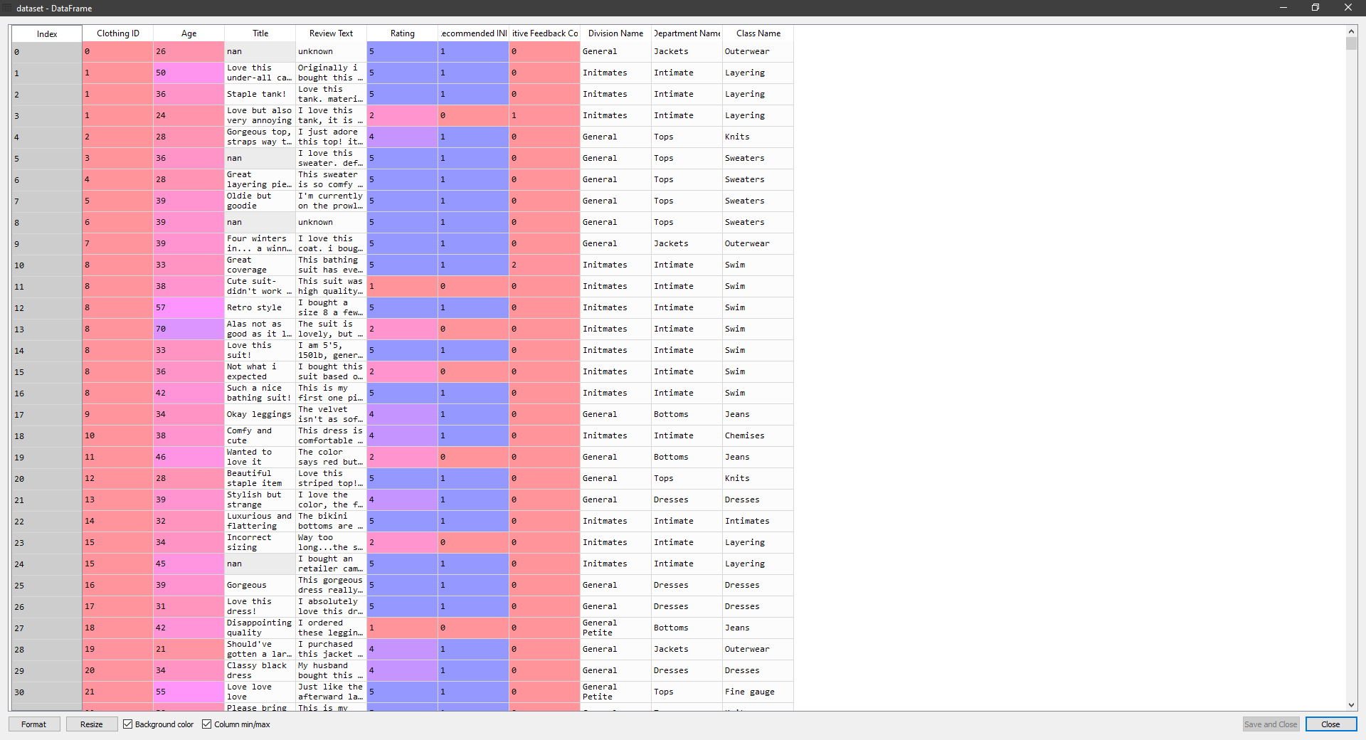
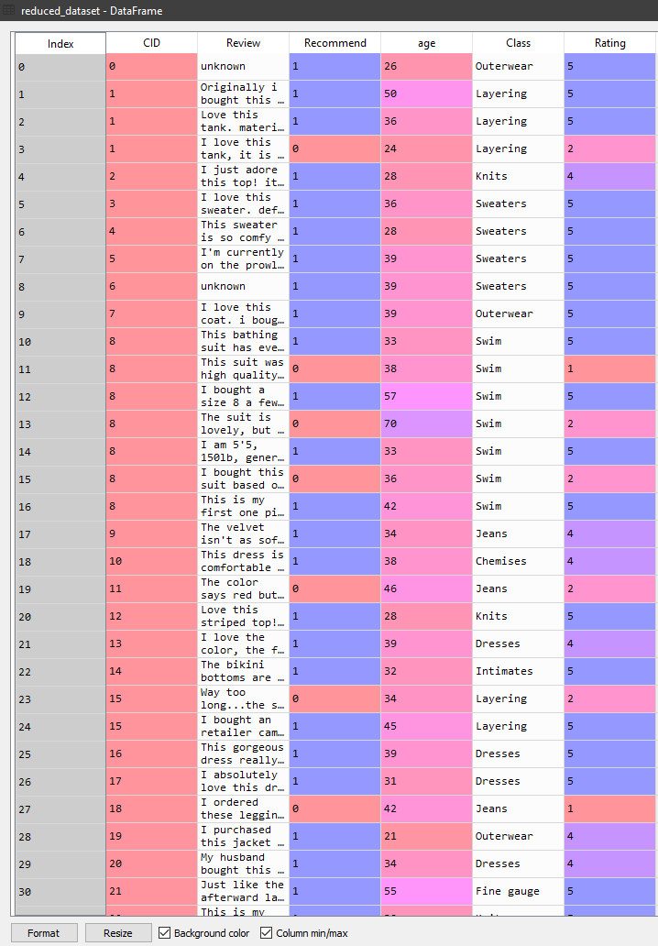
PRE-PROCESSING

Slide 12
REMOVING NOISE
stop = text.ENGLISH_STOP_WORDS
def remove_noise(text):
# Make lowercase
text = text.apply(lambda x: " ".join(x.lower() for x in x.split()))
# Remove whitespaces
text = text.apply(lambda x: " ".join(x.strip() for x in x.split()))
# Remove special characters
text = text.apply(lambda x: "".join([" " if ord(i) < 32 or ord(i) > 126 else i for i in x]))
# Remove punctuation
text = text.str.replace('[^\w\s]', '')
# Remove numbers
text = text.str.replace('\d+', '')
# Remove Stopwords
text = text.apply(lambda x: ' '.join([word for word in x.split() if word not in (stop)]))
# Convert to string
text = text.astype(str)
return text

Slide 13
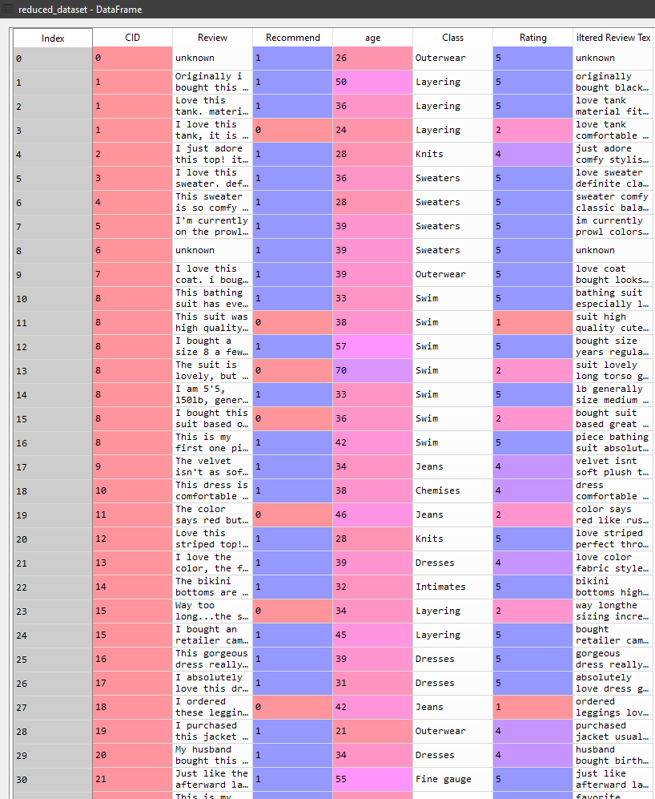
REMOVING NOISE
Reduced dataset after removing noise words from filtered review text

Slide 14
TOKENIZE AND LEMMATIZE
def sentiment_analyser(text):
return text.apply(lambda Text: pd.Series(TextBlob(Text).sentiment.polarity))
# Applying function to reviews
reduced_dataset['Polarity'] = sentiment_analyser(reduced_dataset['Filtered Review Text'])
w_tokenizer = nltk.tokenize.WhitespaceTokenizer()
lemmatizer = nltk.stem.WordNetLemmatizer()
def lemmatize_text(text):
return [lemmatizer.lemmatize(w) for w in w_tokenizer.tokenize(text)]
reduced_dataset['Filtered Review Text'] = reduced_dataset['Filtered Review Text'].apply(lemmatize_text)

Slide 15
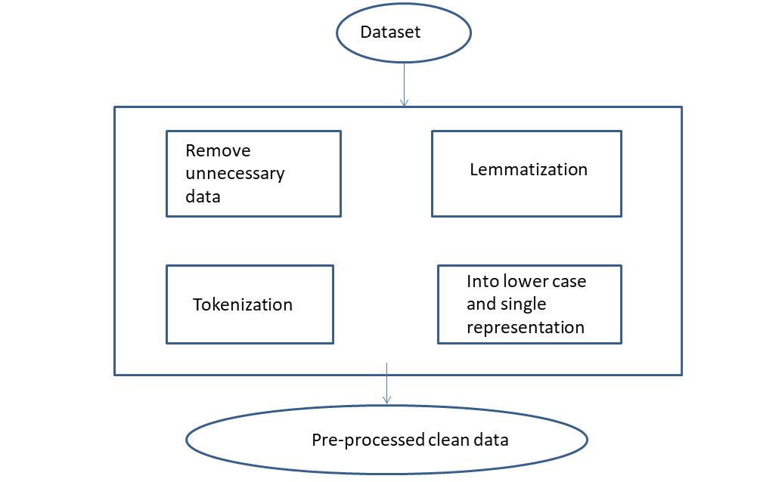

Slide 16
POLARITY
The pre-processed data is polarized to obtain positive , negative, neutral emotions of the review.
Now, the analyser takes the best positive emotions( with value 1) along with user interests to provide with appropriate suggestions. Polarity value ranges from -1 to +1.

Slide 17
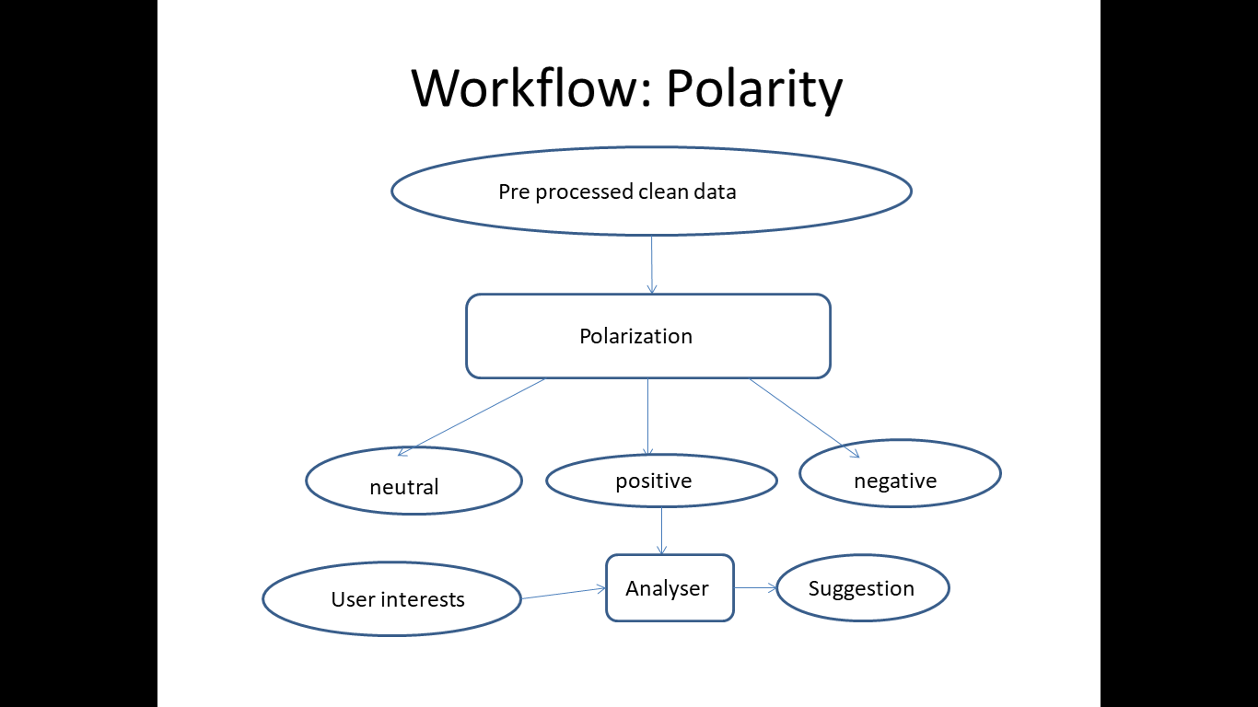
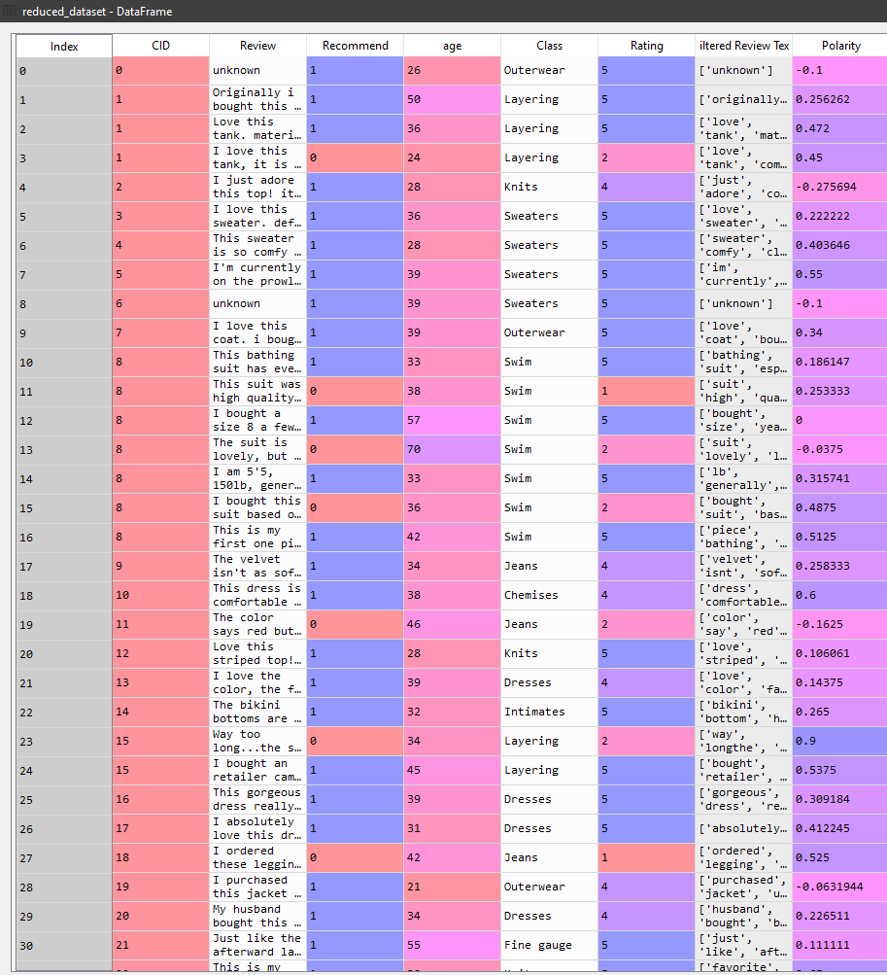
POLARITY
Dataframe with calculated polarity values

Slide 18
Count Vectorizer
We now use Countvectoriser to convert a collection of text documents to a matrix of token counts
This implementation produces a sparse representation of the counts using scipy.sparse.csr_matrix.
If you do not provide an a-priori dictionary and you do not use an analyzer that does some kind of feature selection then the number of features will be equal to the vocabulary size found by analyzing the data.
cvec = CountVectorizer(min_df=.005, max_df=.9, ngram_range=(1,2), tokenizer=lambda doc: doc, lowercase=False)
cvec.fit(reduced_dataset['Filtered Review Text'])
cvec_counts = cvec.transform(reduced_dataset['Filtered Review Text'])
occ = np.asarray(cvec_counts.sum(axis=0)).ravel().tolist()
counts_df = pd.DataFrame({'Term': cvec.get_feature_names(), 'Occurrences': occ})
counts_df.sort_values(by='Occurrences', ascending=False)

Slide 19
CLASSIFIER MODEL
Before passing the dataframe into the classifier we drop all columns that are not a part of the test matrix.
# Drop all columns not part of the text matrix
ml_model = reduced_dataset
We now create 2 variables namely X and y where X holds the attributes age and rating, while y holds Recommend attribute.
# Create X & y variables for Machine Learning
X = ml_model[['age','Rating']]
y = ml_model['Recommend']
We now split the model into train and test sets.
# Create a train-test split of these variables
X_train, X_test, y_train, y_test = train_test_split(X, y, test_size = 0.3, random_state=42)

Slide 20
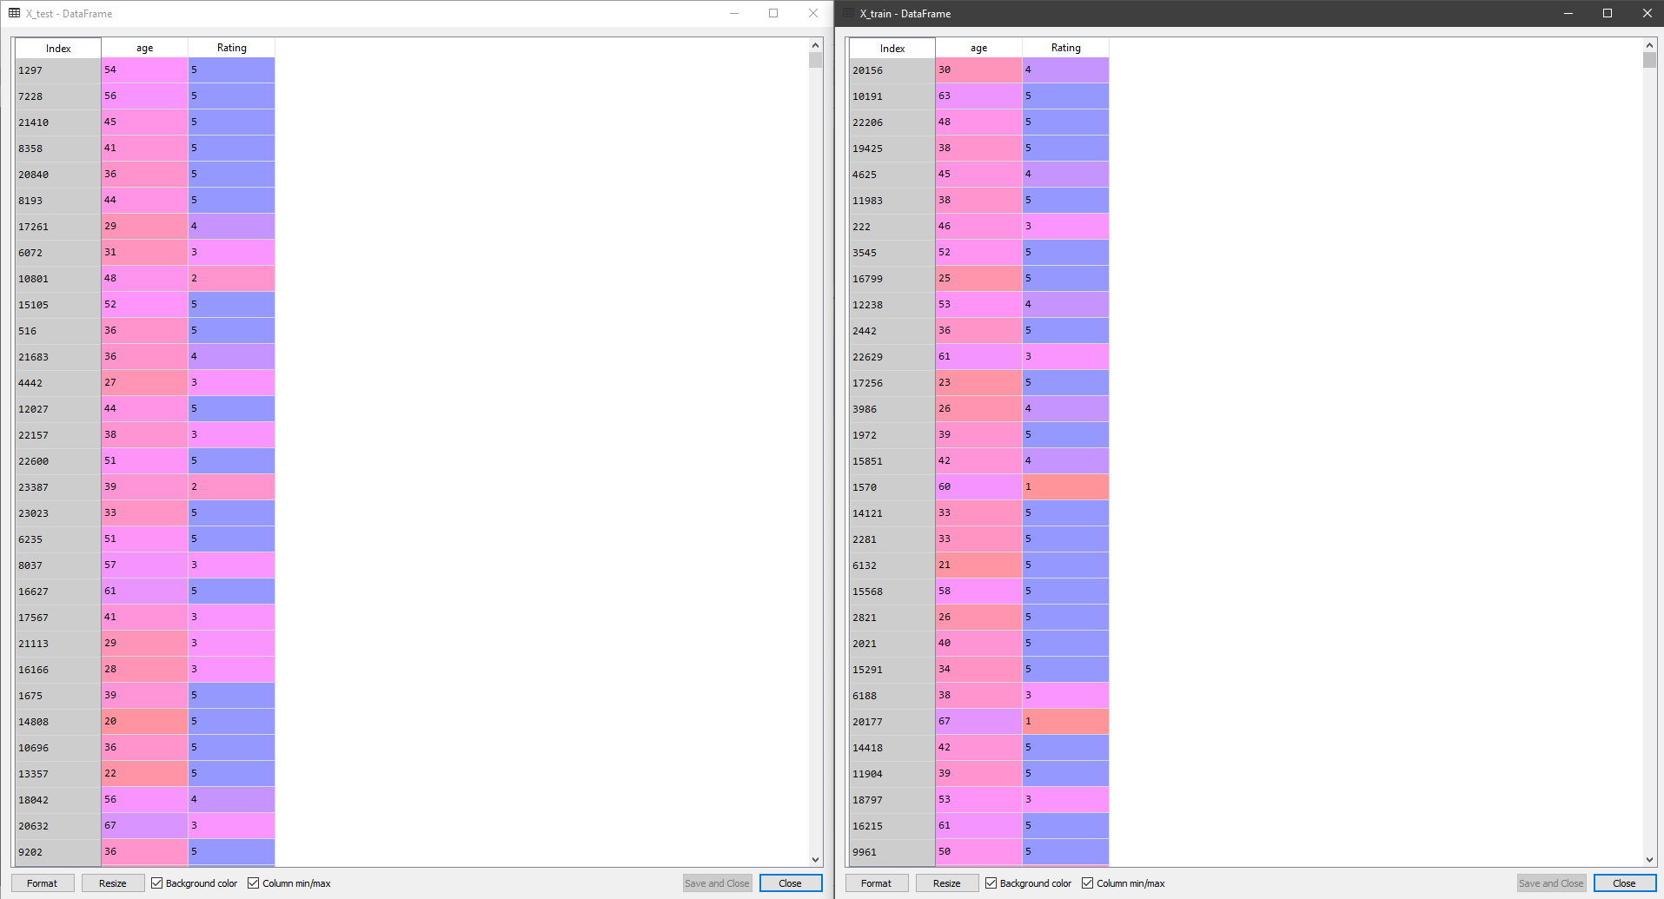
CLASSIFIER MODEL
X test and train dataframes

Slide 21
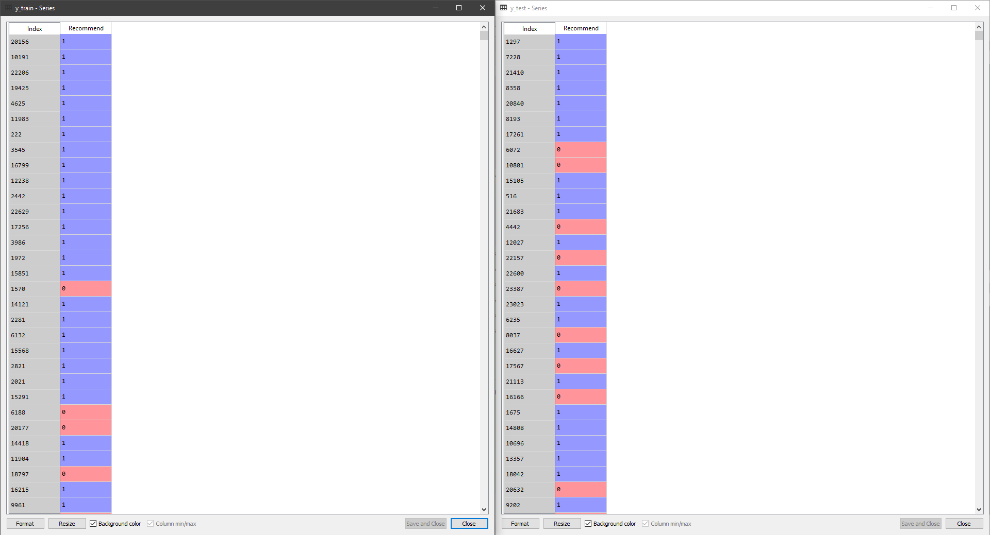
CLASSIFIER MODEL
Y test and train dataframes

Slide 22
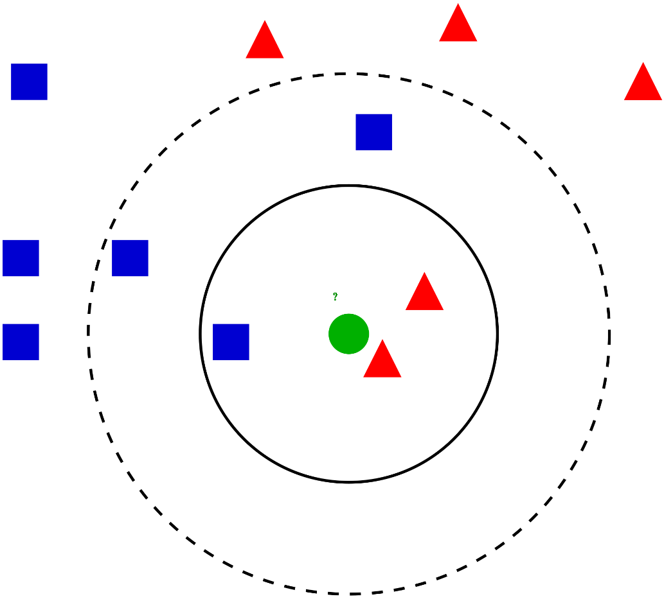
K Nearest Neighbours
KNN can be used for both classification and regression predictive problems. However, it is more widely used in classification problems in the industry. To evaluate any technique we generally look at 3 important aspects:
1. Ease to interpret output
2. Calculation time
3. Predictive Power
KNN Model

Slide 23
KNN implementation
We now pass our classified data into the recomendation engine that takes user age and minimum rating as input and recommend 100 neighbouring ID’s of the cloths out of which we’ll display the top 10 to the user.
def cloth_recommendation(age,rating):
neigh = NearestNeighbors(n_neighbors=100)
neigh.fit(X_train,y_train)
recomended_items=neigh.kneighbors([[age,rating]],return_distance=False)
recomended_items=recomended_items.transpose()
recomended_items=recomended_items.flatten()
nearest_data=reduced_dataset.loc[recomended_items,:]
high_rated_df=nearest_data[nearest_data['Rating']>=rating]
final_output=high_rated_df[high_rated_df['Recommend']==1]
sorted_output=final_output.sort_values(by=['Polarity'],ascending=False)
return sorted_output

Slide 24
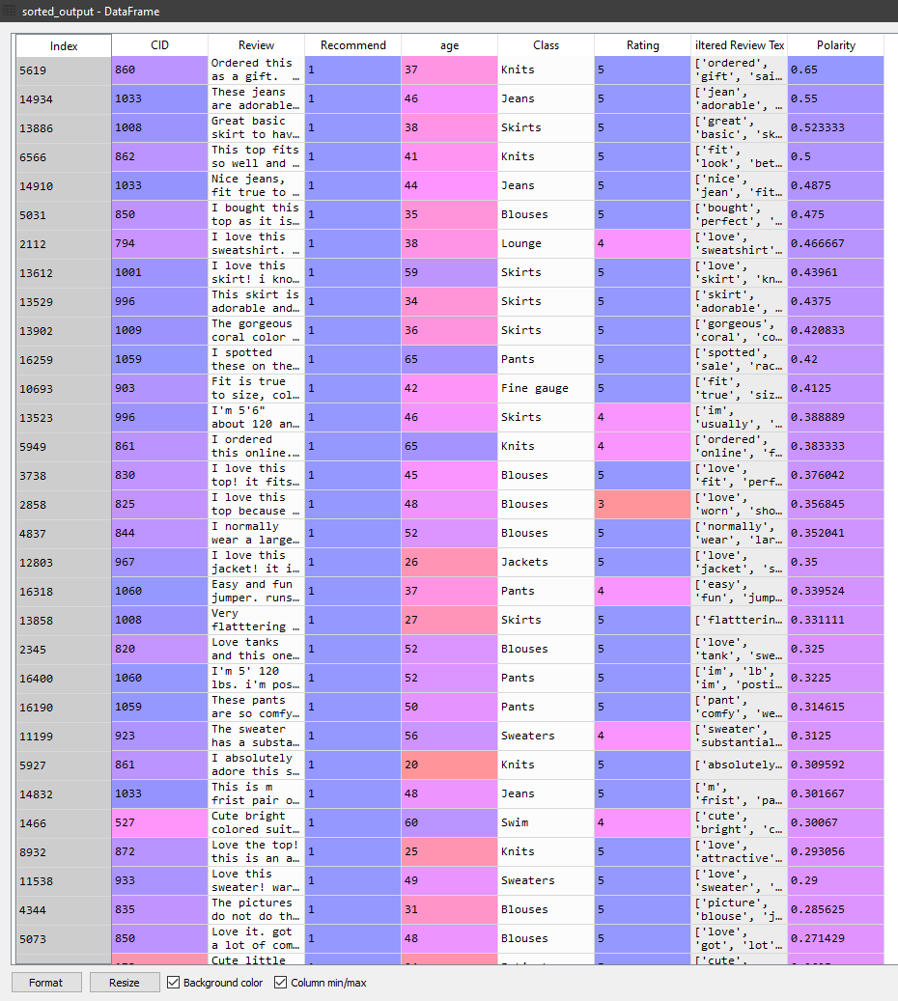
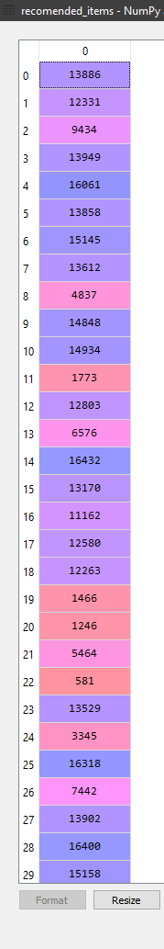
KNN implementation
Sorted dataframe from the KNN implementation.
100 recomended items stored in recomended items.

Slide 25
Graphical User Interface
For the GUI we are gonna use an python library known as Tkinter that provides us with a shell based windowed interface, which can be easily customised to suit our needs.
Importing Tkinter
from tkinter import *
from tkinter.ttk import *
from tkinter import messagebox

Slide 26
Graphical User Interface
Implementing the GUI using Tkinter
window = Tk()
window.title("Predictor")
window.geometry('1000x1000+300+0')
lbl = Label(window, text="Enter your Age:",font = ("Times 16 bold",20))
lbl.grid(column=0, row=0)
txt = Entry(window,width=10)
txt.grid(column=1, row=0)
lbl2 = Label(window, text="Enter the minimum rating:",font = ("Times 16 bold",20))
lbl2.grid(column=0, row=2)
txt2 = Entry(window,width=10)
txt2.grid(column=1, row=2)
#tex=Text(window)
#tex.grid(column=1,row=3)
text1 = Text(window)
text1.grid(column=1,row=3)
def clicked():
a=int(txt.get())
b=int(txt2.get())
#We now pass the age and minimum rating value to the recomendation engine
recomended_data=cloth_recommendation(a,b)
text1.insert(END, str(recomended_data.iloc[:10,0]))
btn = Button(window, text="Submit", command=clicked)
btn.grid(column=1, row=8)
window.mainloop()

Slide 27
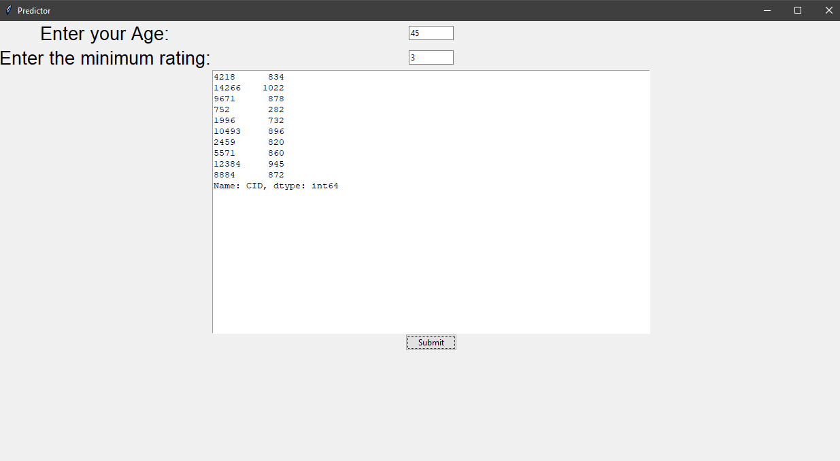
Graphical User Interface

Slide 28
Conclusion and Future Scope
CONCLUSION
Through this project we were able to explore the vast libraries and modules present in NLP and also understand and implement few of machine learning algorithms. Sentiment analysis helped us to provide the users with best recommended clothing ID. Also, K Nearest Neighbours algorithm helped us to provides the customers an easy and efficient way to know which type of cloth would suit their style based on their age and overall rating, resulting in a formation of a mart of brands and clothing style that match the ID.
FUTURE SCOPE
Differentiating between fake and honest reviews.
Provision for removal of redundant and old reviews.
Provision for adding of new reviews, updating the dataset.
Increasing the capacity of training set and hence increasing the efficiency of the prediction model for future data.
Ability to try out various Machine learning algorithms such as Multinomial Naïve Bayes algorithm, Random Forest Tree Classifier, etc.
We could also implement a Confusion Matrix to better understand the accuracy of the algorithm.

Slide 29
Thank You!!!

